Slide 1
Applications of Unsupervised Automatic Speech Recognition in Different Domains
Project Advisor: Dr. Stas Tiomkin
Team Members: Akhil Reddy Dooliganti
Naga Venkata Sai Sathwik Edupuganti
Srikara Mohana Sai Sachin Nekkanti
Sudheer Tati

Slide 2
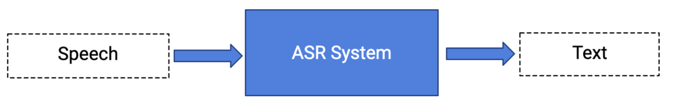
Automatic Speech Recognition(ASR)
What is ASR?
Converting Audio signals -> Text
[without any human intervention]
Why is ASR for dysarthria important?
Communication with voice assistants like Siri and Google Assistant, promotes inclusive communication.
Notes:
ASR is automatic speech recognition, it is a method of converting audio signals into text without any human interaction.
In this project we intend to create a ASR model in an unsupervised approach; thus contributing to low-resource languages and people with disabilities. Using the unsupervised approach, we require no labelled data to train the model.

Slide 3
Methodology
Datasets
UA-Speech Dataset (Dysarthria Dataset)
TORGO Dataset (Dysarthria Dataset)
Libri Speech
Baseline Model
XLSR-53 (Self-supervised Model)
wav2vec-U (Unsupervised Model)
wav2vec-U 2.0 (Unsupervised Model)

Slide 4
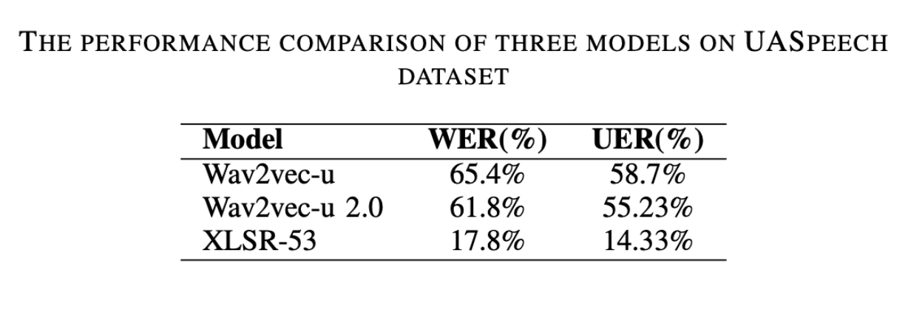
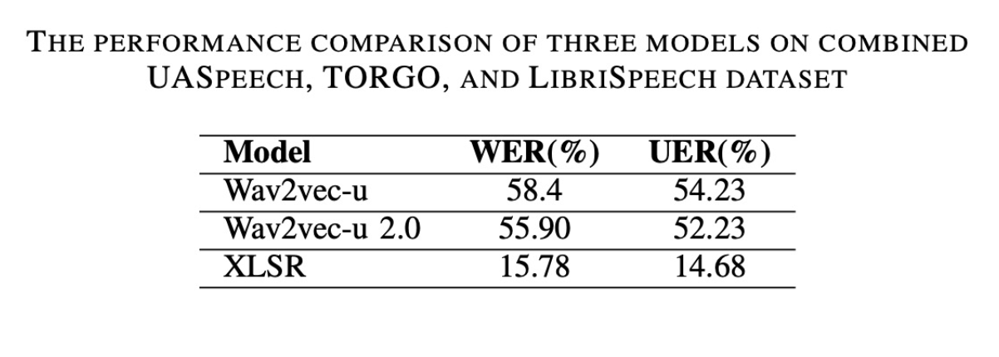
Results

Slide 5

Thanks!
https://huggingface.co/sudheer997/final-project

Slide 6
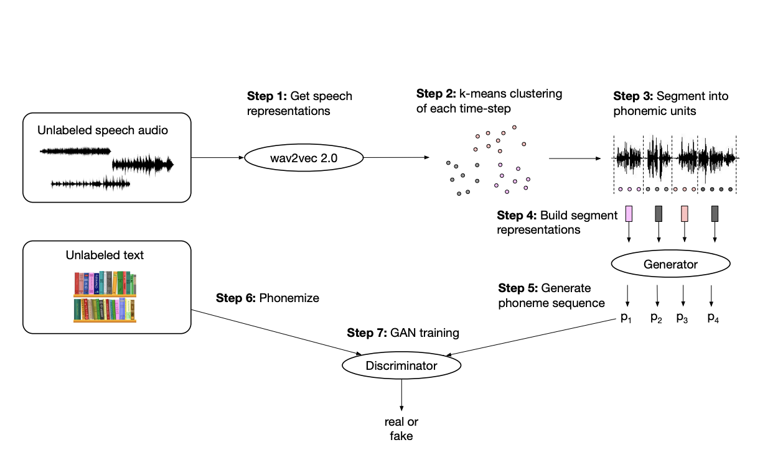
Architecture
Input the unlabelled speech audio
Generate Speech Representations using the wav2vec 2.0 framework
Create the clusters using the k-means for each time-step, and segment them into phonemic units.
Reduce the number of dimensions using PCA.
Wav2Vec-Unsupervised

Slide 7
Methodology - Cont’d
Segment representations are fed into the generator and it outputs the probability distribution of phoneme sequences.
Discriminator classifies whether the generated phoneme sequences from the generator are from the real distribution.
Wav2Vec-Unsupervised

